Slide 1
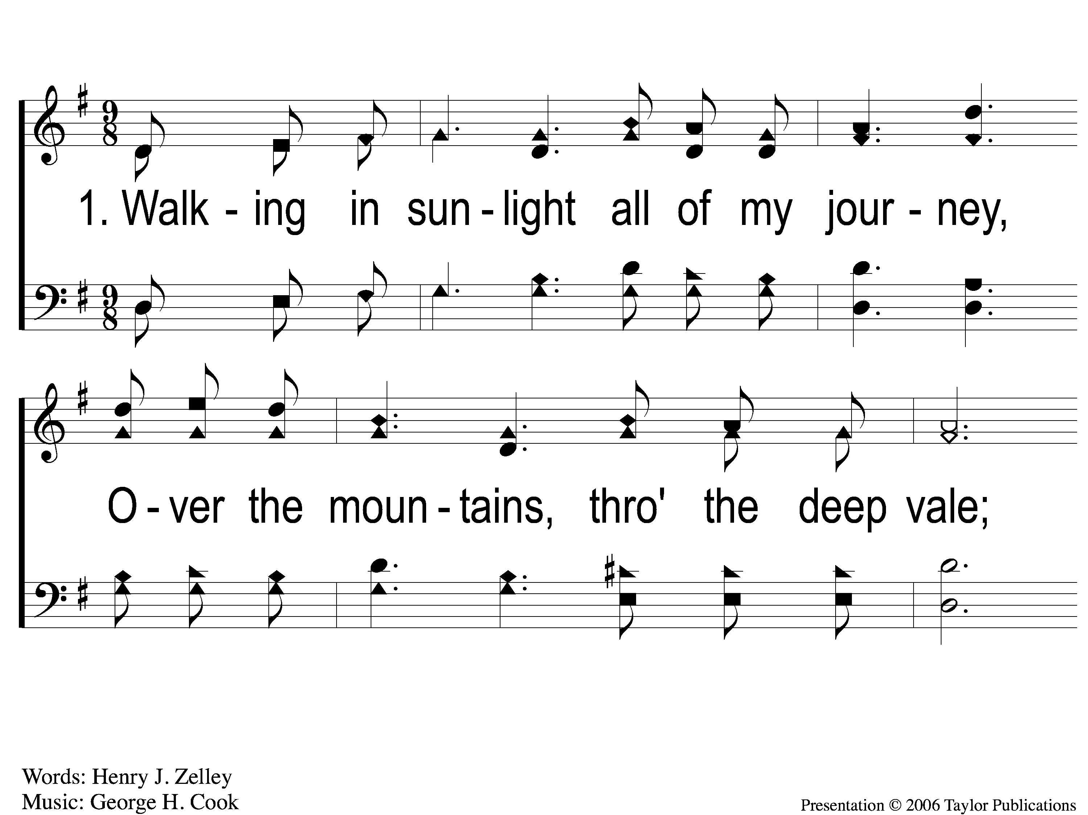
1-1 Heavenly Sunlight
Heavenly Sunlight
168

Slide 2
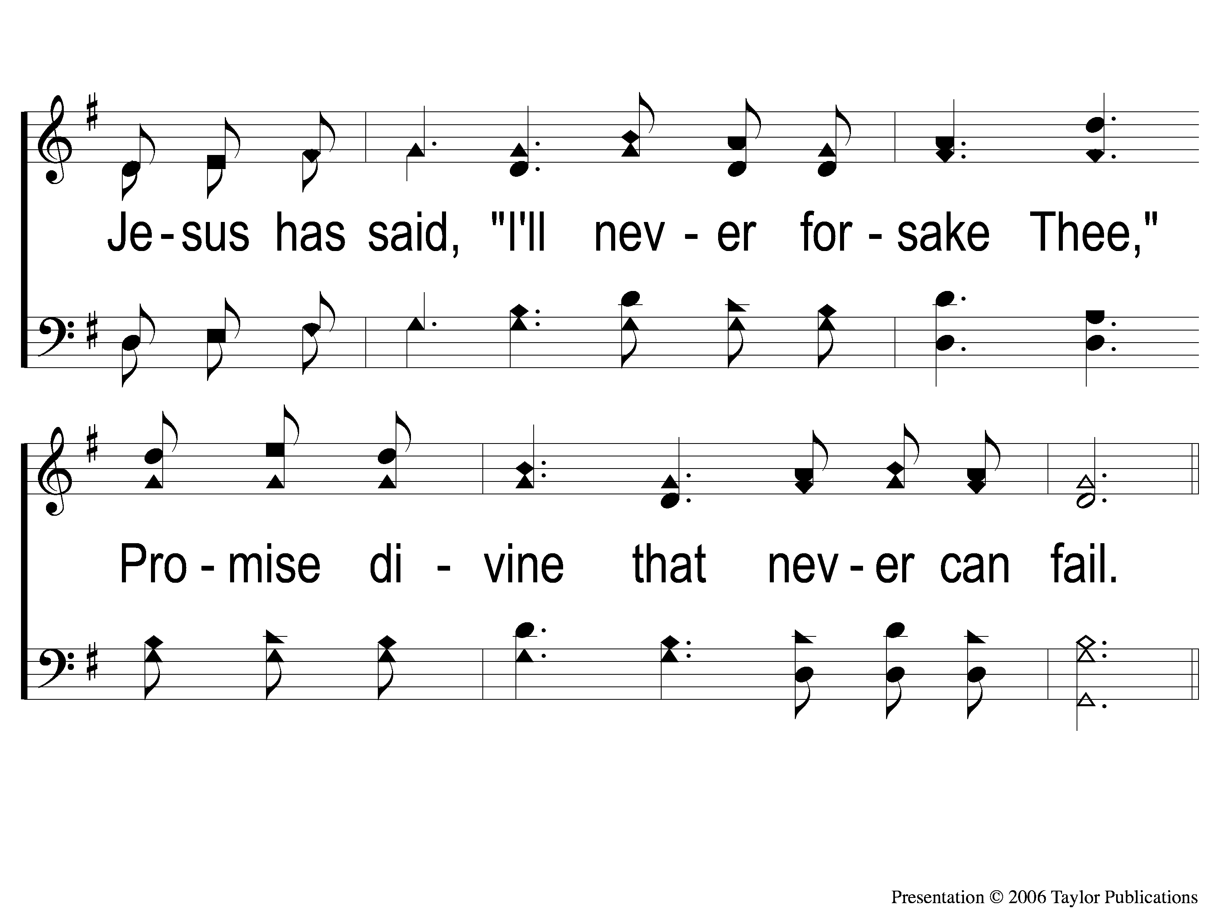
1-2 Heavenly Sunlight
Heavenly Sunlight
168

Slide 3
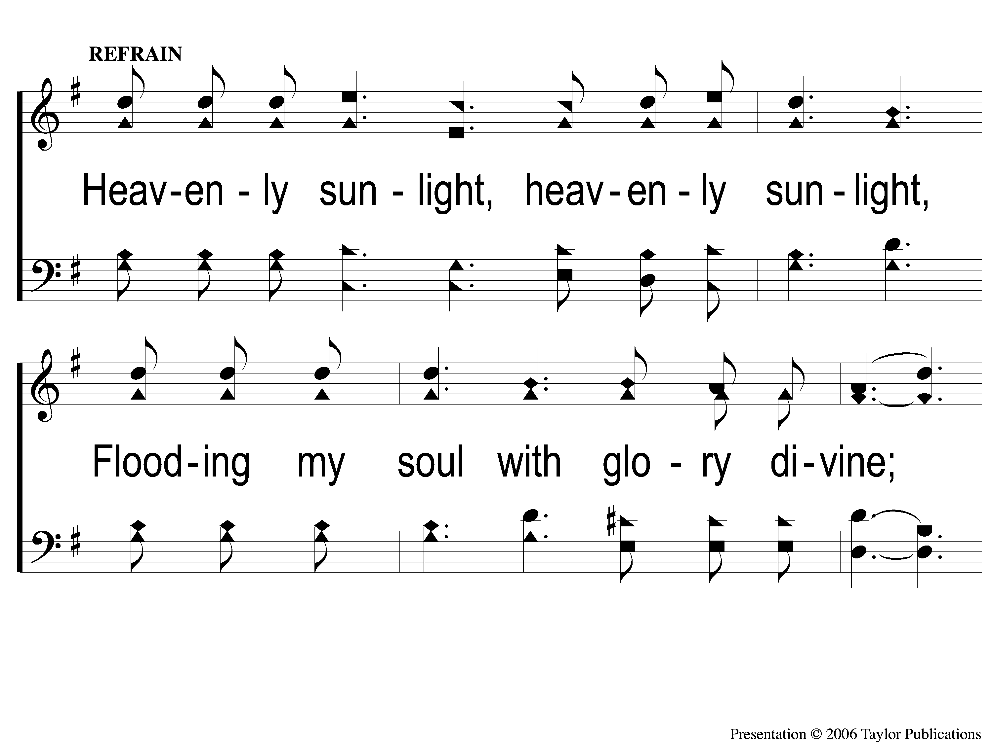
C-1 Heavenly Sunlight
Heavenly Sunlight
168

Slide 4
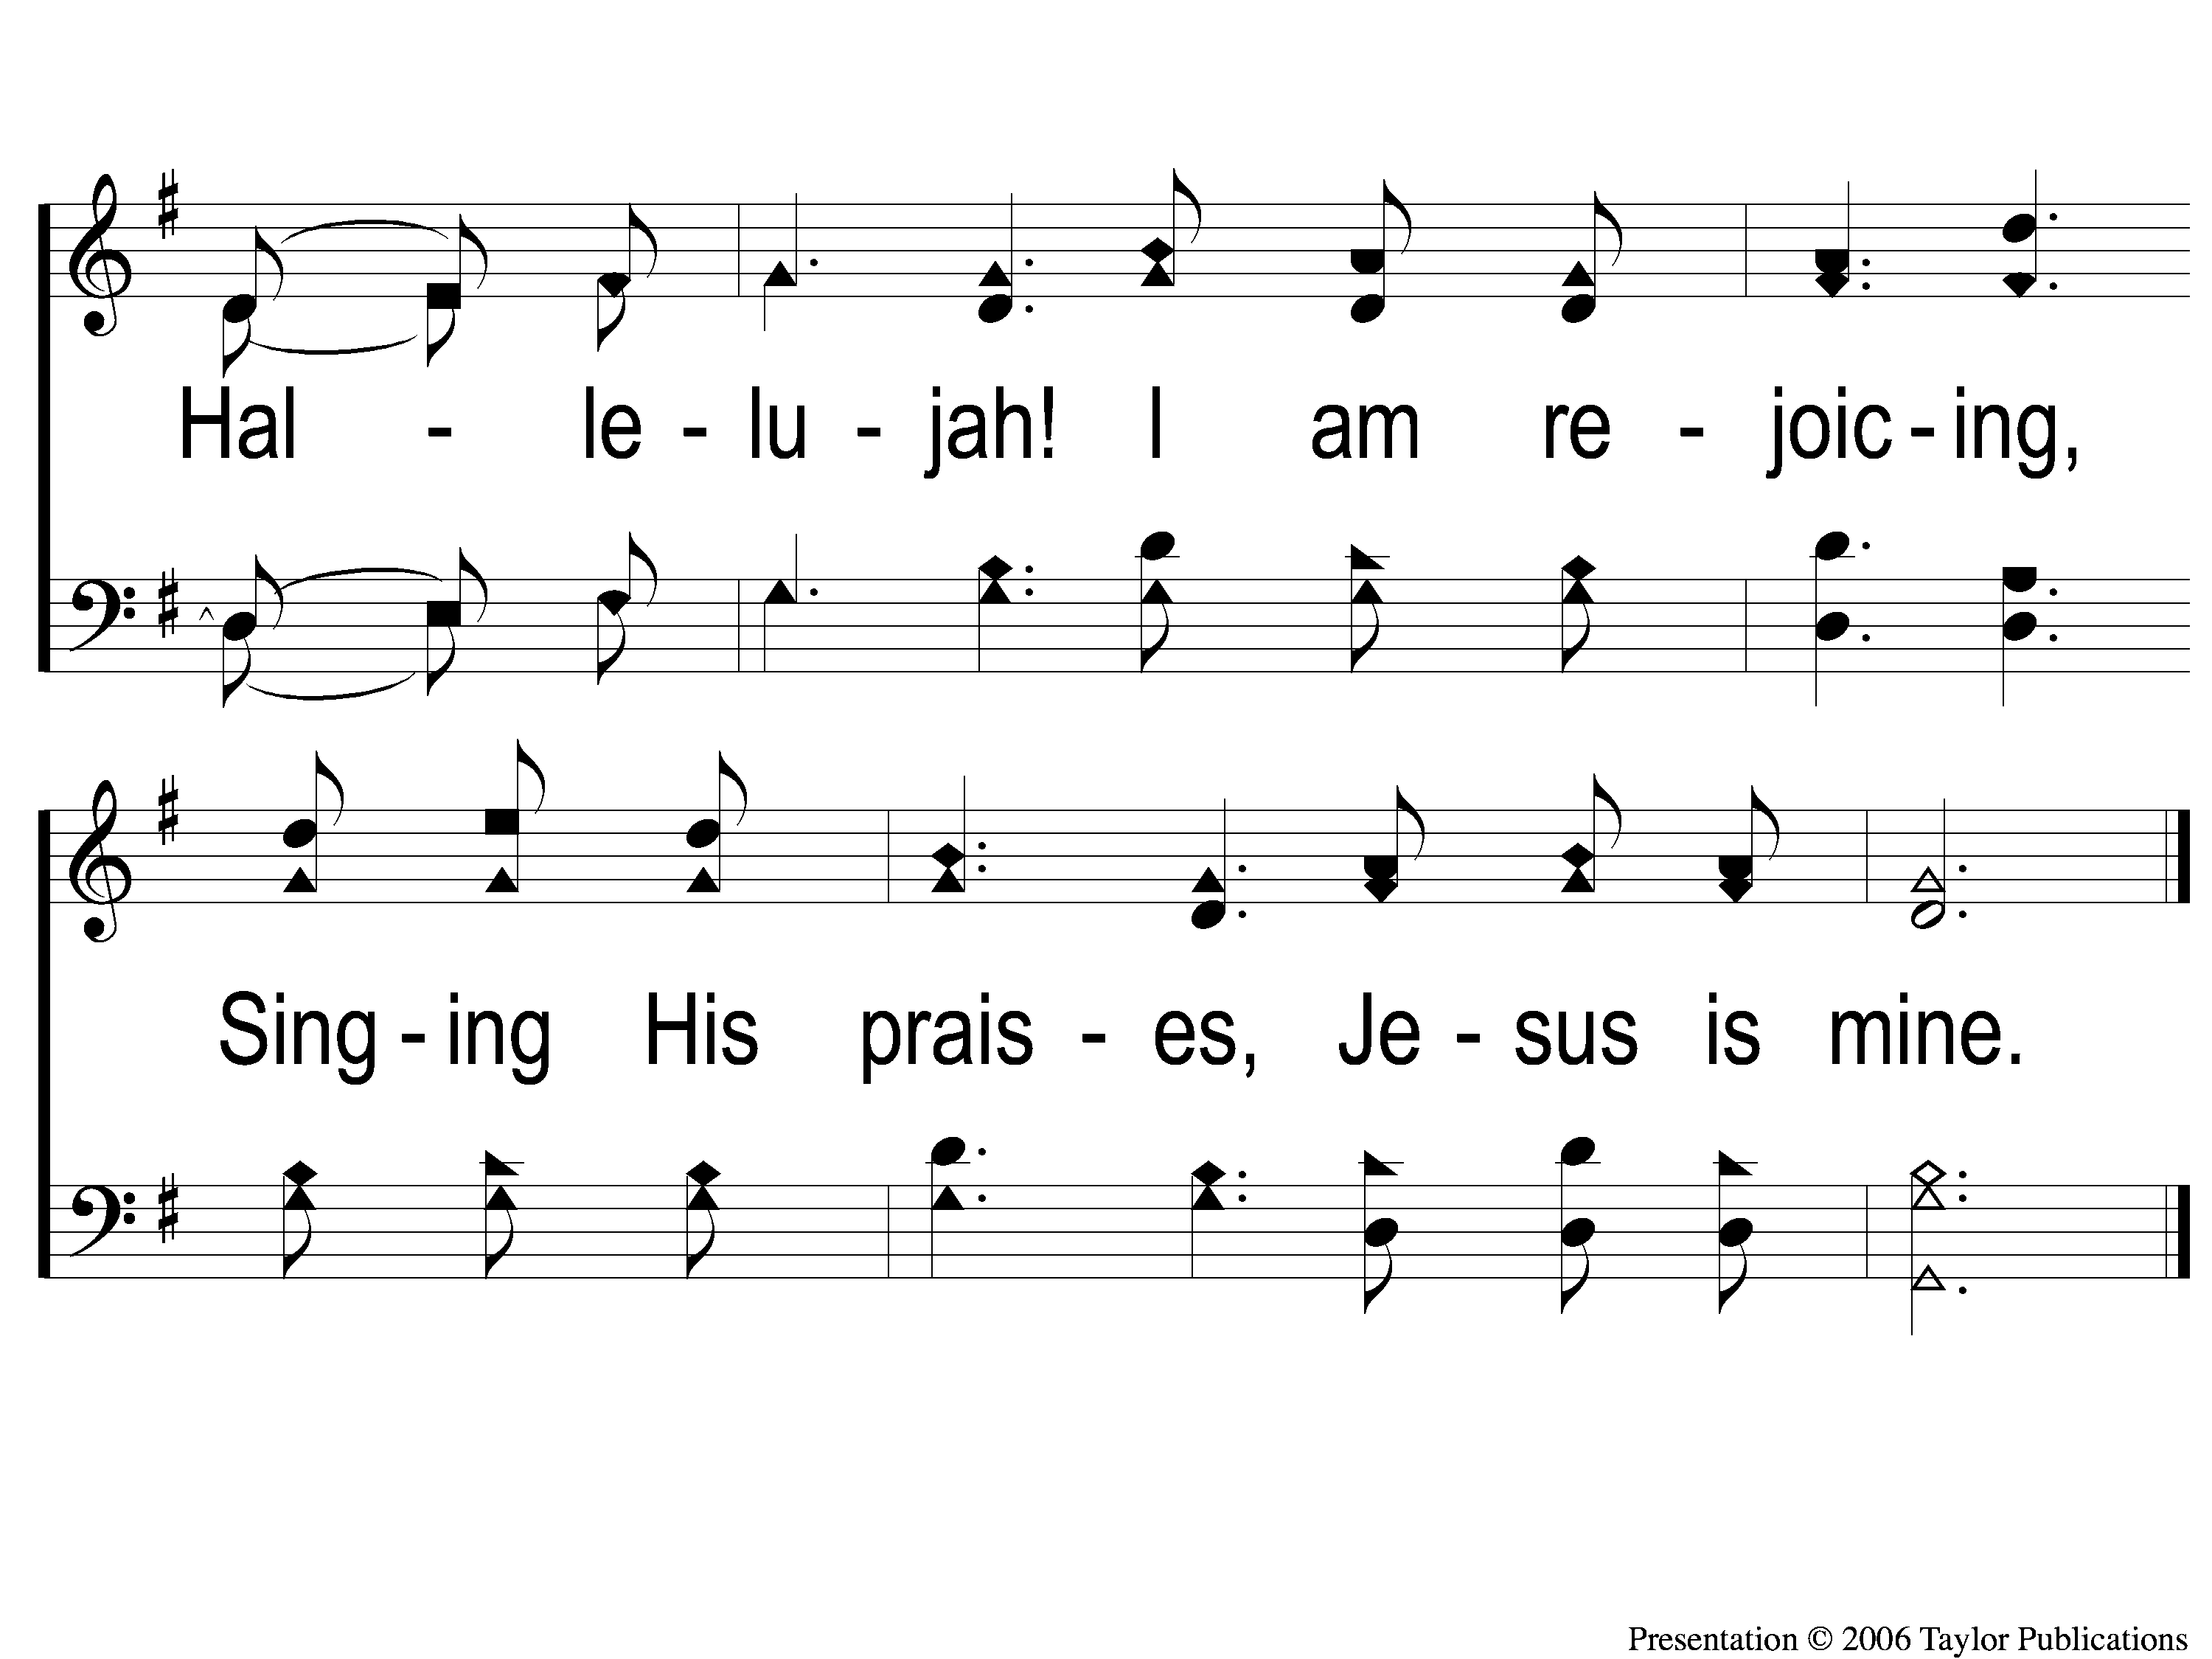
C-2 Heavenly Sunlight
Heavenly Sunlight
168

Slide 5
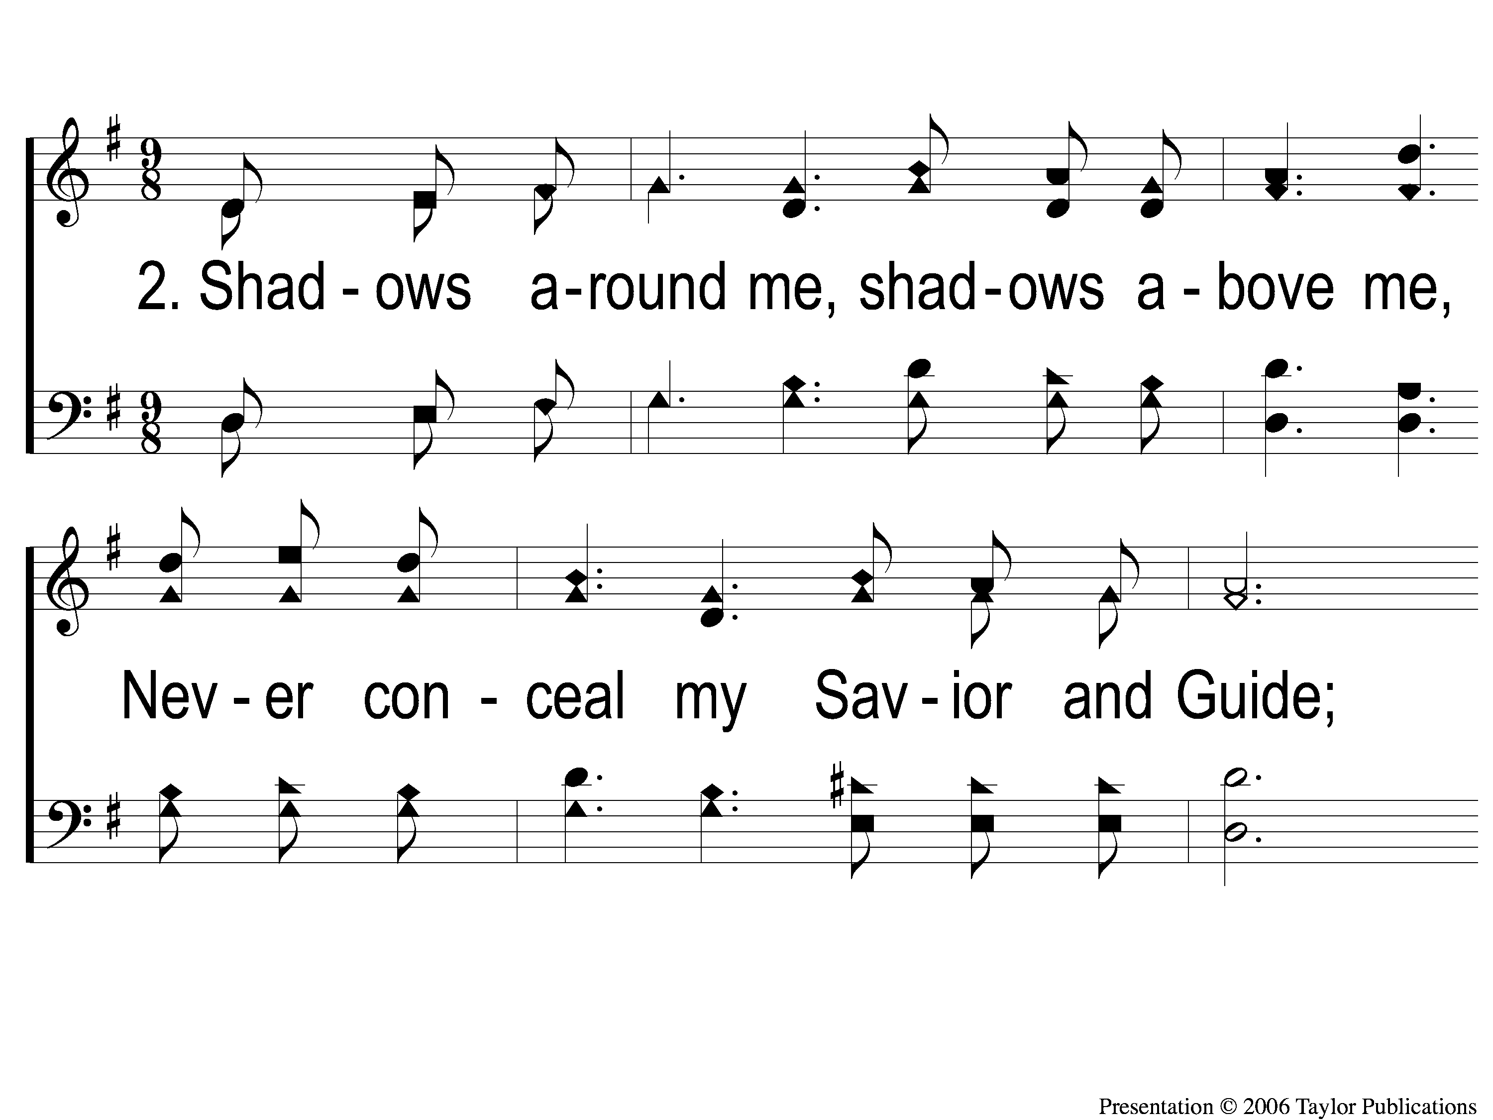
2-1 Heavenly Sunlight
Heavenly Sunlight
168

Slide 6
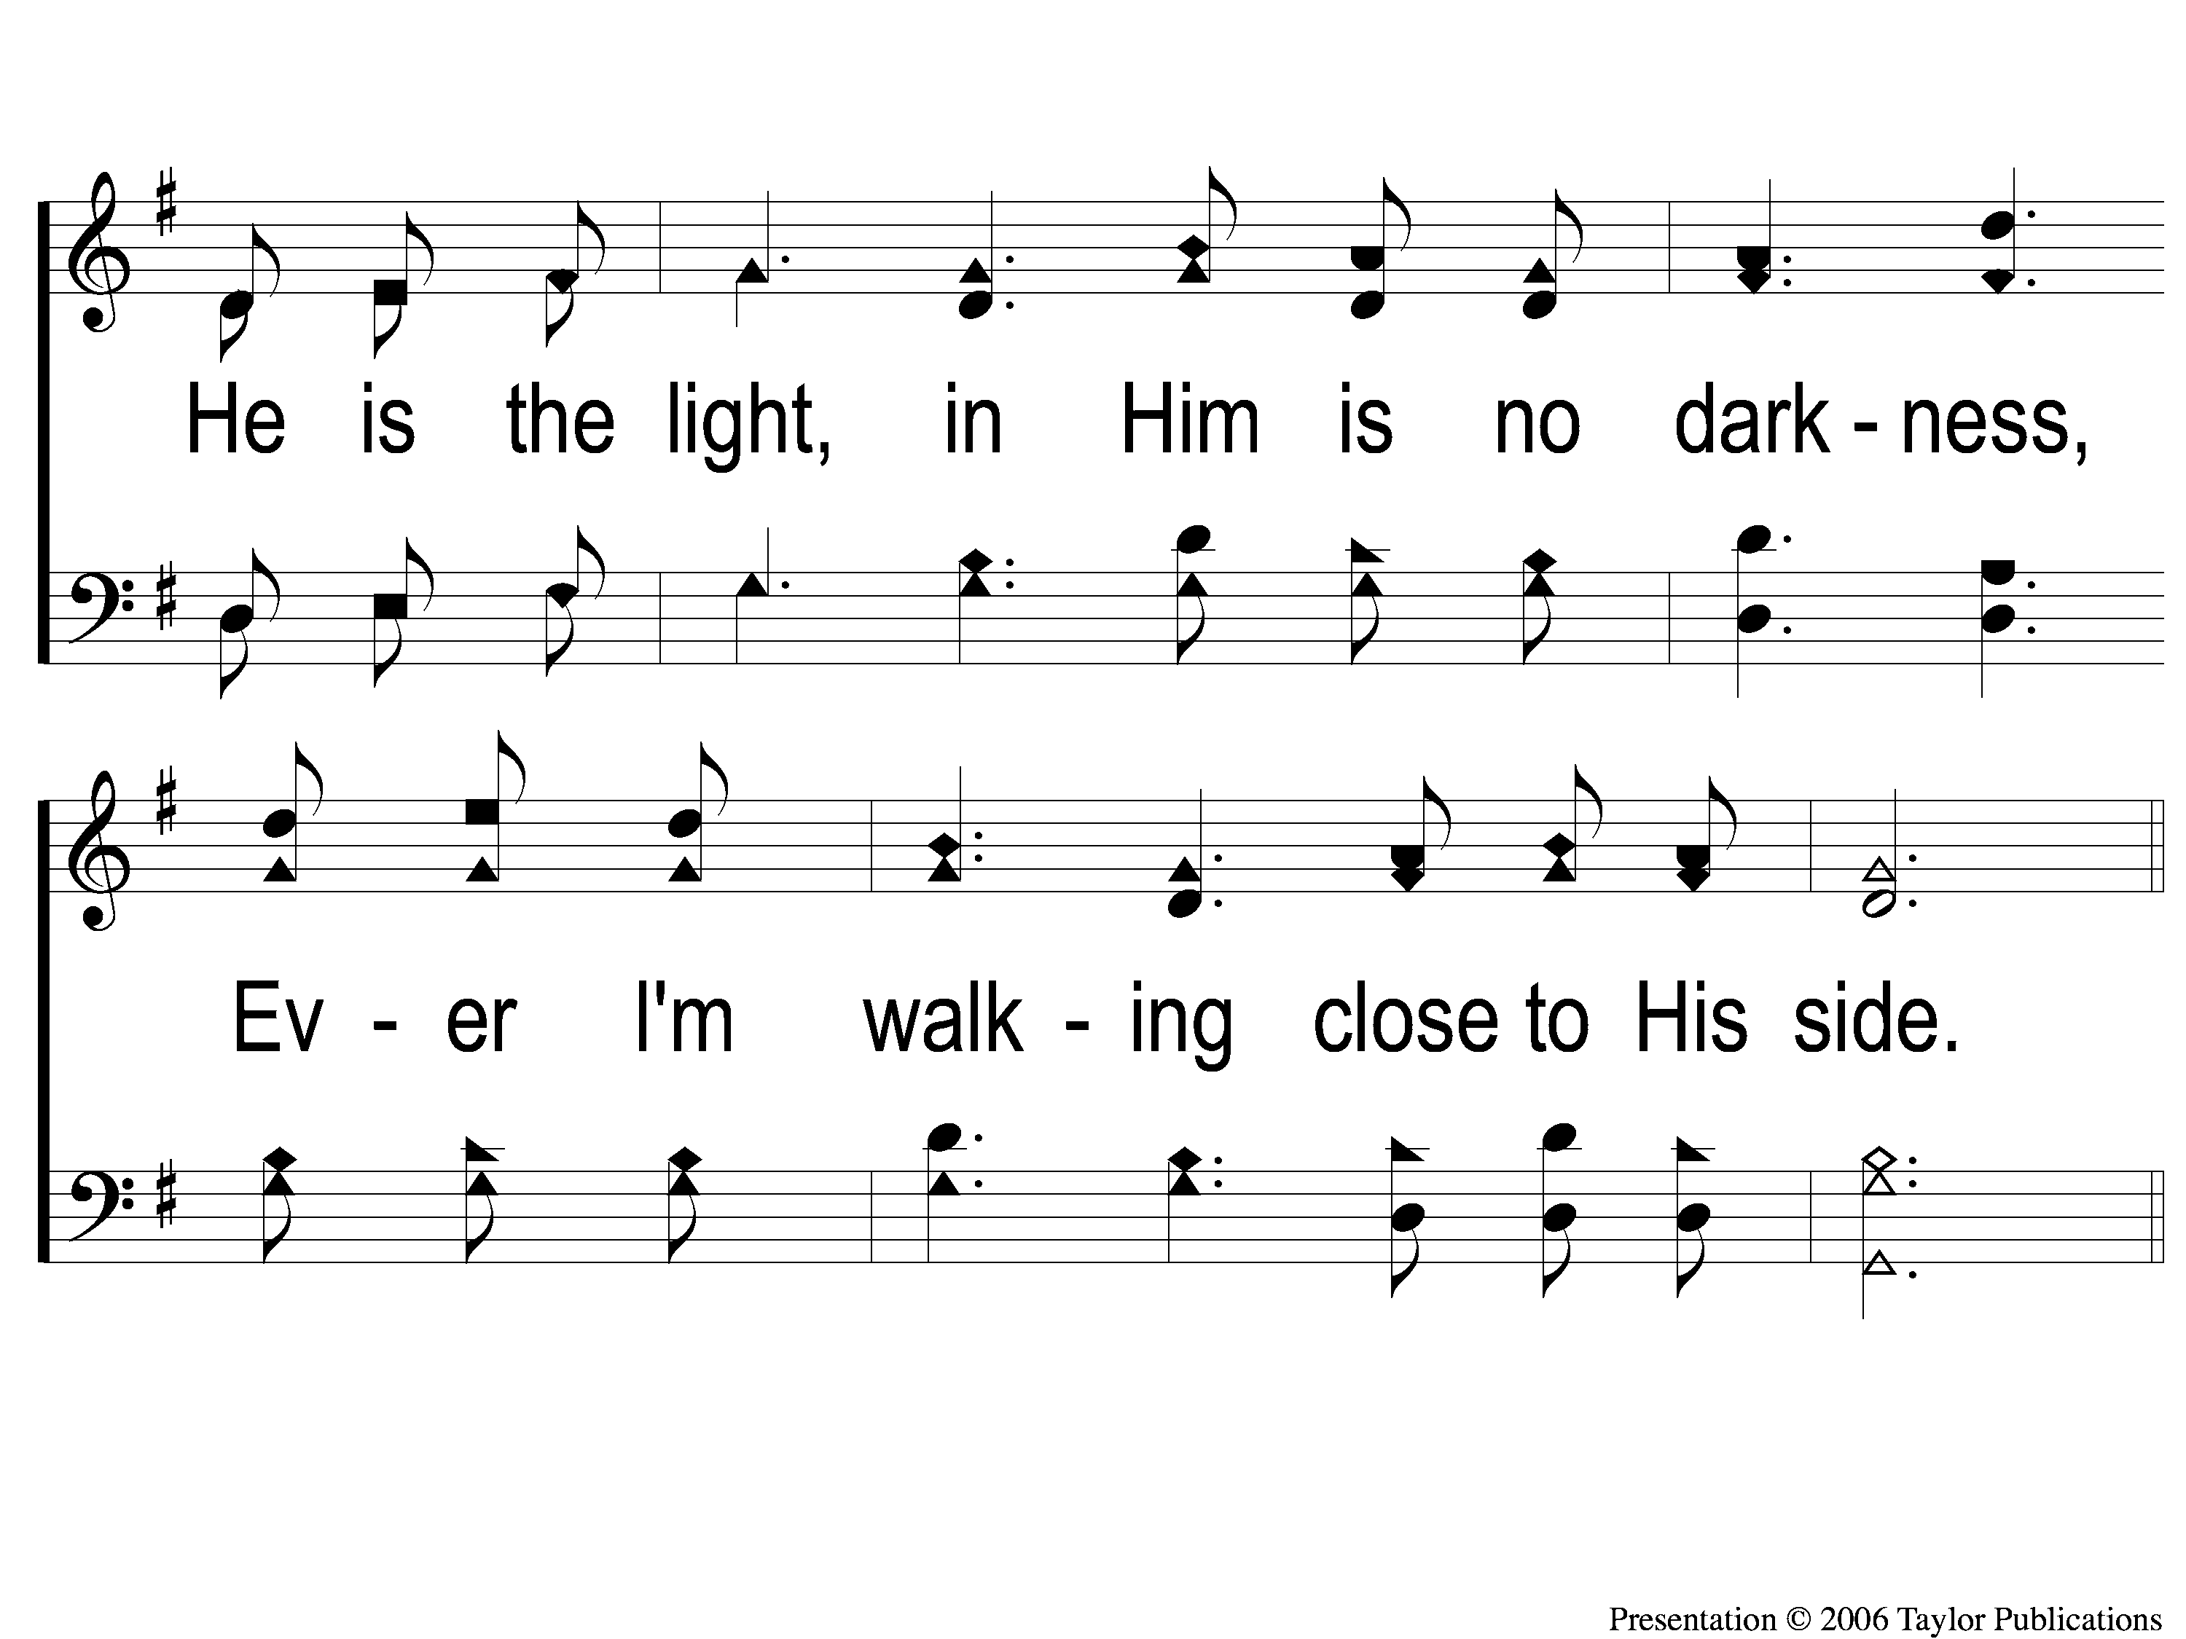
2-2 Heavenly Sunlight
Heavenly Sunlight
168

Slide 7
C-1 Heavenly Sunlight
Heavenly Sunlight
168

Slide 8
C-2 Heavenly Sunlight
Heavenly Sunlight
168

Slide 9
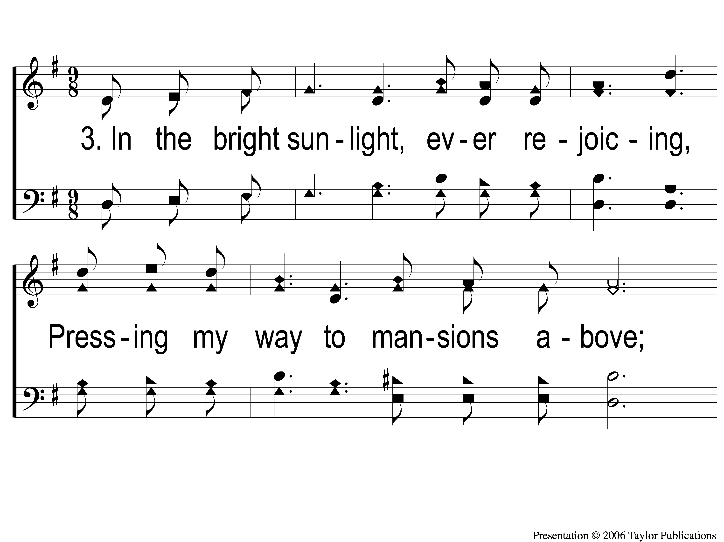
3-1 Heavenly Sunlight
Heavenly Sunlight
168

Slide 10
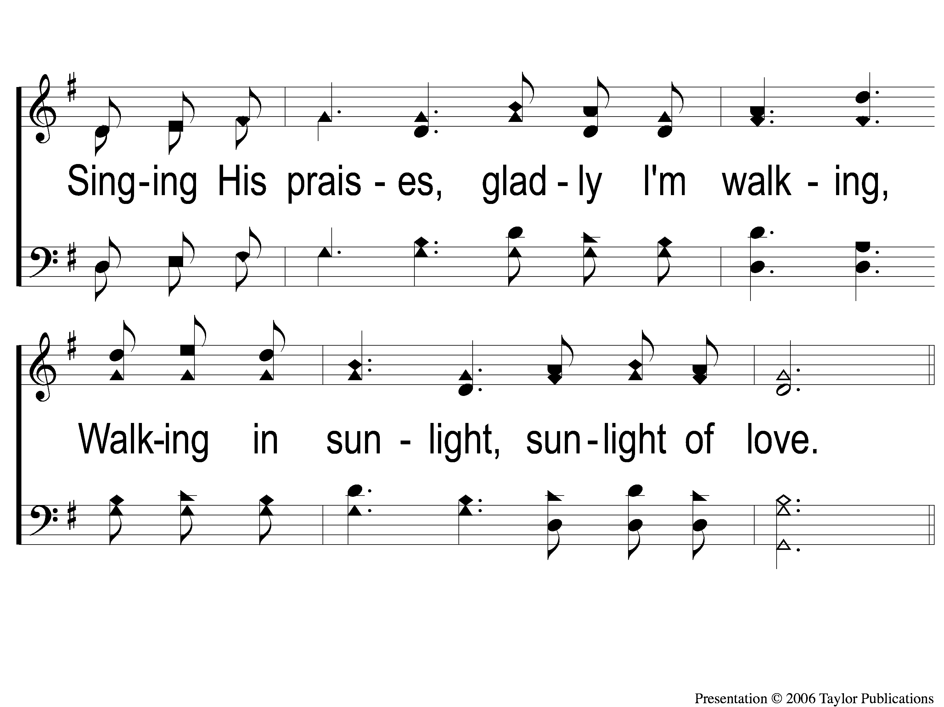
3-2 Heavenly Sunlight
Heavenly Sunlight
168

Slide 11
C-1 Heavenly Sunlight
Heavenly Sunlight
168

Slide 12
C-2 Heavenly Sunlight
Heavenly Sunlight
168

